Slide 1
Predicting Traffic Congestion in Hong Kong with Open Data: A Practical Undergraduate Capstone
Chan Man Tik (22D021) submitted for the degree of Bachelor of Science in Applied Data Science of Hong Kong Shue Yan University Supervisor: Prof. Ka Lun, FAN Year: 2026

Slide 2
Motivation and Aims
Central corridor is a critical CBD route with heavy and variable traffic
Official AADT data are stored in multiple XML files and tables
Difficult to compare links and years directly
Objectives:
Build one clean combined AADT dataset
Extract a Central‑corridor subset
Analyse trends for each link
Test simple baseline models for AADT forecasts

Slide 3
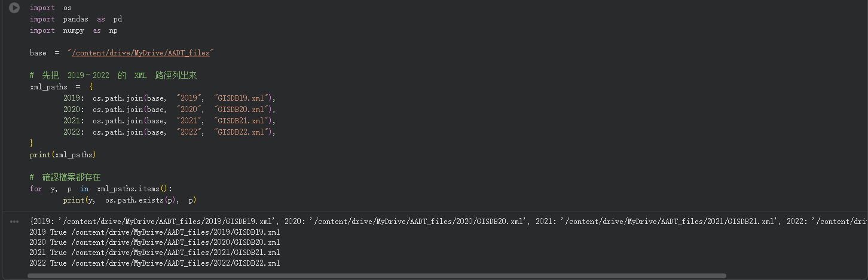
Data Sources and Processing
Source files: GISDB19.xml, GISDB20.xml, GISDB21.xml, GISDB22.xml, GISDB23.xml, GISDB24.xml
Years covered: 2019, 2020, 2021, 2022, 2023, 2024
For each XML file:
Infer year from filename
Read PSTnList table into pandas
Clean numeric fields: PreAADT, CurAADT, ChangeAADT
Create link key: region + station number (for example, HK_1022)
Combined dataset: about 10,077 rows, 14 columns
Save final dataset as: hk_aadt_all_years.csv

Slide 4
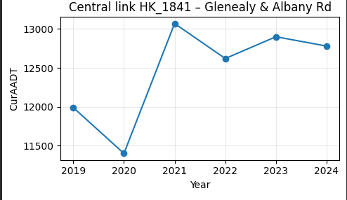
Central Corridor Dataset and Trends
Define Central corridor using road‑name keywords:
“HARCOURT ROAD”, “CONNAUGHT ROAD”, “QUEENSWAY”, “COTTON TREE DRIVE”
plus nearby streets: “GLENEALY”, “UPPER ALBERT ROAD”, “QUEEN’S ROAD CENTRAL”, etc.
Filter hk_aadt_all_years.csv by RoadName to create df_central
Central subset size: 54 records (2019–2024)
Examples of Central links:
HK_1411, HK_1608, HK_2212 – Cotton Tree Drive
HK_1007, HK_1816, HK_2013 – Queensway
HK_1464 – Harcourt Rd (FO ramp to Cotton Tree Drive)
HK_1841 – Glenealy & Albany Rd
General trend:
AADT drops around 2020–2022
AADT rebounds in 2023–2024

Slide 5
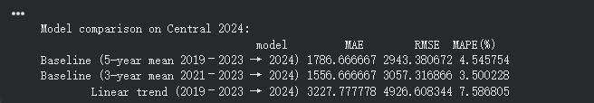
Baseline and Linear Models (Predicting 2024)
Goal: predict 2024 AADT for Central links from earlier yearsModels tested:Baseline: 5‑year mean AADT (2019–2023)Baseline: 3‑year mean AADT (2021–2023)Linear trend: regression of CurAADT on year (2019–2023)Evaluation metrics for Central 2024:5‑year mean baseline (2019–2023 → 2024):MAE ≈ 1,786, RMSE ≈ 2,943, MAPE ≈ 4.6%3‑year mean baseline (2021–2023 → 2024):MAE ≈ 1,557, RMSE ≈ 3,057, MAPE ≈ 3.5%Linear trend (2019–2023 → 2024):MAE ≈ 3,228, RMSE ≈ 4,926, MAPE ≈ 7.6%Best performing model: 3‑year mean baselineLinear trend model is less accurate for 2024

Slide 6
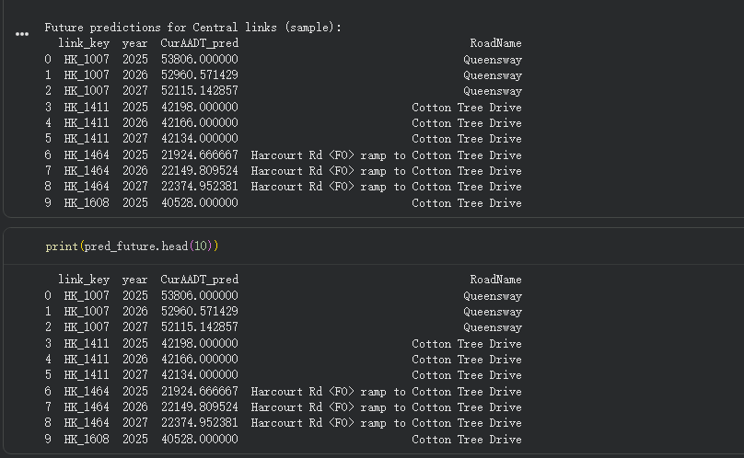
Examples of Central Links and Forecasts to 2027
For each Central link, plot:
Actual CurAADT for 2019–2024 (blue line)
Linear prediction for 2024 (red dot)
Example Central links in the plots:
HK_1411 – Cotton Tree Drive
HK_1816 – Queensway
HK_1007 – Queensway
HK_1464 – Harcourt Rd (FO ramp to Cotton Tree Drive)
HK_2013 – Queensway
HK_1841 – Glenealy & Albany Rd
Observations:
For some links, linear prediction is close to actual 2024
For other links, linear prediction over‑ or under‑shoots
Extend linear regression using full 2019–2024 history
Forecast years: 2025, 2026, 2027 for each Central link
Example (Queensway, HK_1007):
Predicted AADT remains in low–mid 50,000 range in 2025–2027

Slide 7
Key Findings, Limitations, and Next Steps
Key achievements:
Automated pipeline from XML files to a clean CSV dataset
Defined and extracted a Central corridor subset of links
Visualised link‑level AADT trends from 2019 to 2024
Quantitatively compared simple models for 2024 prediction
Main findings:
Central links show a COVID‑era dip followed by recovery in 2023–2024
A very simple 3‑year mean baseline outperforms the linear trend model for 2024
Limitations:
Only AADT history is used; no land‑use, population, or transit variables
Short time series; results not suitable for detailed engineering design
Focus only on Central corridor
Future work:
Add explanatory variables and richer time‑series models
Extend to other corridors or the whole Hong Kong network
Package results into an interactive dashboard or widget‑based tool

